Slide 1
RAJALAKSHMI ENGINEERING COLLEGE
OCS1903-PROGRAMMING USING PYTHON
Dictionary

Slide 2
CONTENTS
Dictionary
Dictionary Creation
Operators and Methods
Examples

Slide 3
Towards Dictionaries
Lists, tuples, and strings hold elements with only integer indices
In essence, each element has an index (or a key) which can only be an integer, and a value which can be of any type (e.g., in the above list/tuple, the first element has key 0 and value 45)
  What if we want to store elements with non-integer indices (or keys)?
45 | “Coding” | 4.5 | 7 | 89
0 | 1 | 2 | 3 | 4
Integer Indices

Slide 4
Dictionaries {}
In Python, you can use a dictionary to store elements with keys of any hashable types (e.g., integers, floats, Booleans, strings, and tuples; but not lists and dictionaries themselves) and values of any types
The above dictionary can be defined in Python as follows:
  dic = {"NUM":45, 1000:"coding", 2000:4.5, 3.4:7, "XXX":89}
45 | “Coding” | 4.5 | 7 | 89
“NUM” | 1000 | 2000 | 3.4 | “XXX”
keys of different types
Values of different types
key
value
Each element is a key:value pair, and elements are separated by commas

Slide 5
Dictionaries {}
  Can contain any and different types of elements (i.e., hashable keys & values)
  Can contain only unique keys but duplicate values
  Can be indexed but only through keys (i.e., dic2[“a”] will return 1 but dic2[0] will return an error since there is no element with key 0 in dic2)
Output: {'a': 2, 'b': 2}
dic2 = {"a":1, "a":2, "b":2}
print(dic2)
The element “a”:2 will override the element “a”:1
because only ONE element can have key “a”

Slide 6

Dictionary-{}
Dictionary is a composite data type in python similar to list.
A dictionary consists of a collection of key-value pairs.
Each key-value pair maps the key to its associated value.
Dictionary is mutable.
  One Dictionary can be nested within another Dictionary.
  Can’t be concatenated.
As list elements are accessed through their index, Dictionary elements are accessed via keys.
Dictionary is mutable

Slide 7
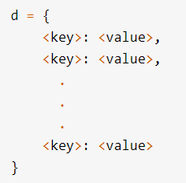
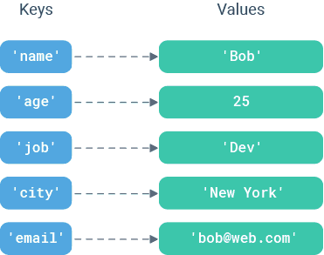
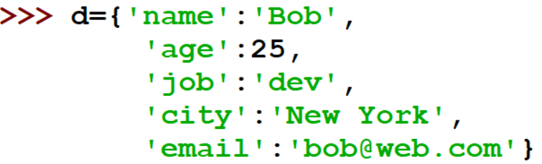
Dictionary-{} Creation
Dictionary encloses comma separated list of key :value pairs.

Slide 8
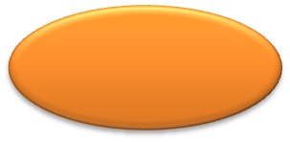
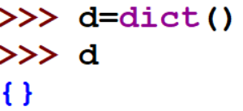
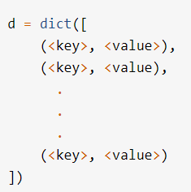



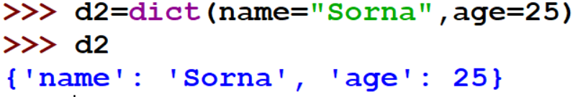
Dictionary-{} Creation
Empty dictionary
List of tuples converted to dictionary
String as arguments,converted to dictionary

Slide 9
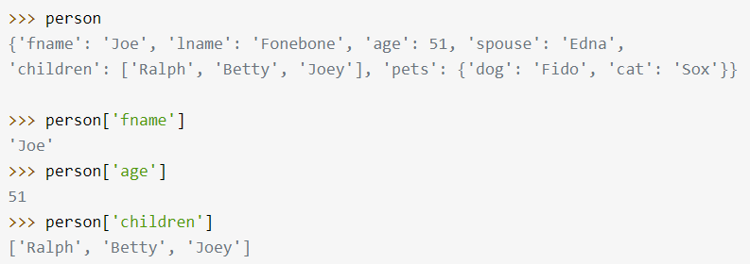

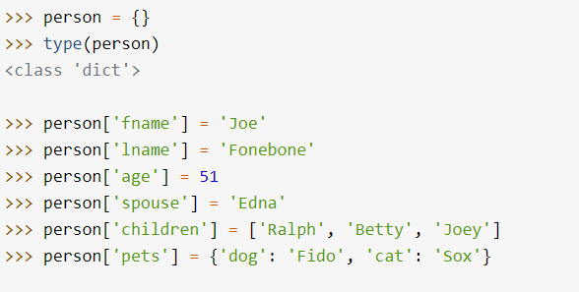
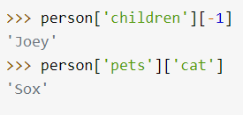
Dictionary-{} Creation
Building a Dictionary Incrementally

Slide 10
Restrictions that dictionary keys must abide
Almost any type of value can be used as a dictionary key in Python . However, there are a couple restrictions that dictionary keys must abide by.
key can appear in a dictionary only once.
Duplicate keys are not allowed.
If you specify a key a second time during the initial creation of a dictionary, the second occurrence will override the first
A dictionary key must be of a type that is immutable.

Slide 11
  Can be iterated or looped over
dic = {"first": 1, "second": 2, "third": 3}
for i in dic:
print(i)
first
second
third
ONLY the keys will be returned.
Output:
How to get the values?

Slide 12
Dictionaries {}
  Can be iterated or looped over
dic = {"first": 1, "second": 2, "third": 3}
for i in dic:
print(dic[i])
1
2
3
Output:
Values can be accessed via indexing!

Slide 13
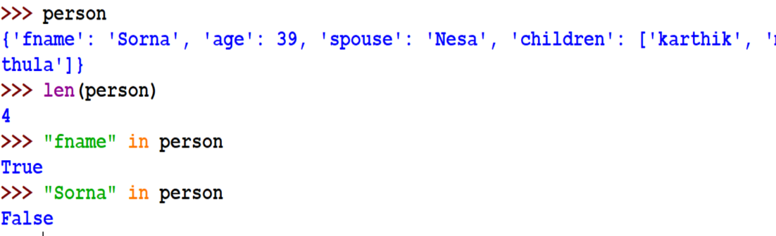
Operators and Built-in Functions
len() function can be used to find the no of key:value pairs in the dictionary.
Operators: Membership operator can be used in dictionary
Membership operator is used for keys alone

Slide 14
Dictionary Functions
Function | Description
dic.clear() | Removes all the elements from dictionary dic
dic.copy() | Returns a copy of dictionary dic
dic.items() | Returns a list containing a tuple for each key-value pair in dictionary dic
dic.get(k) | Returns the value of the specified key k from dictionary dic
dic.keys() | Returns a list containing all the keys of dictionary dic
dic.pop(k) | Removes the element with the specified key k from dictionary dic
dict.popitem() | Similar to get(),but will set dic[key]=default if key is not already in dic.

Slide 15
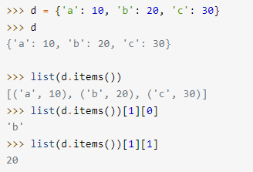
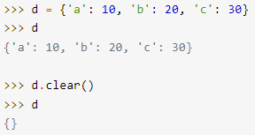
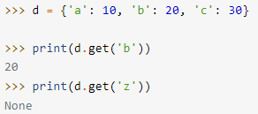
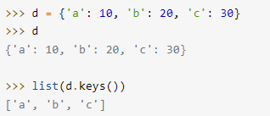
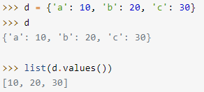
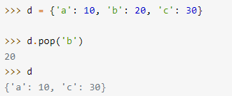
clear()
items()
get()
keys()
values()
pop()

Slide 16
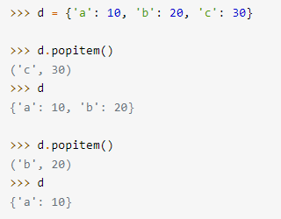
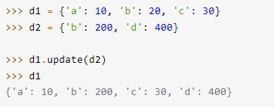
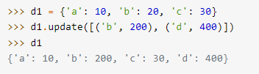
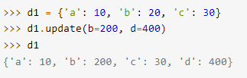
popitem()
update()

Slide 17

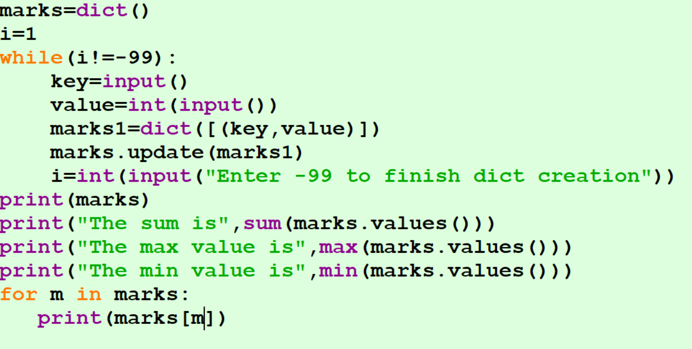
Write a Python program to find sum, maximum and minimum values of the values of a dictionary and print the dictionary
Example 1
Input:
{“Apple”:88,”Orange”:90,”Banana”:78}
Output:
Sum=256
Max:90
Min:78

Slide 18
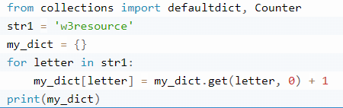

Write a Python program to create a dictionary from a string.
Example 2

Slide 19
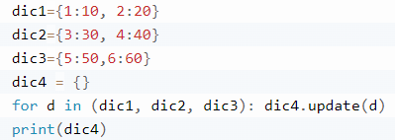

Write a Python program to concatenate following dictionaries to create a new one.
Example 3

Slide 20


